Slide 1
Tecnologia de solos: módulo erosão
gerd sparovek (lso/esalq)
gerd@usp.br
segundo semestre de 2016

Slide 2
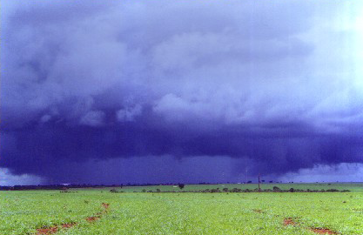
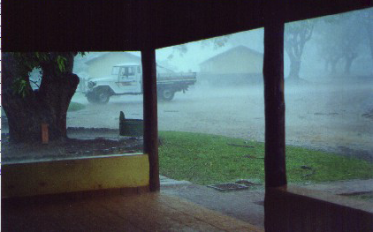

Slide 3
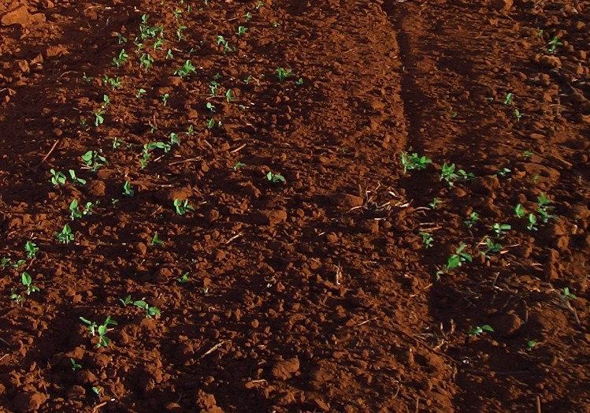
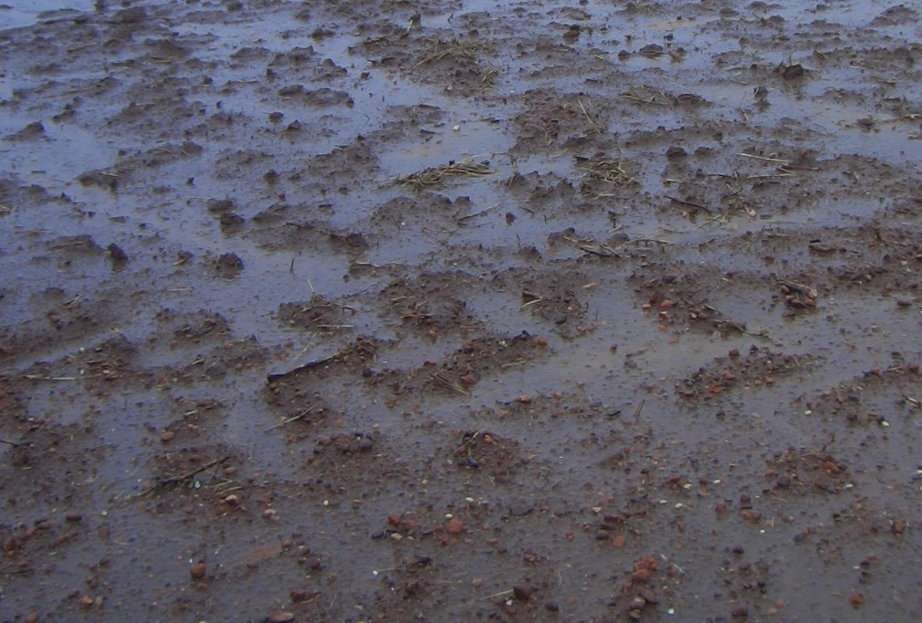
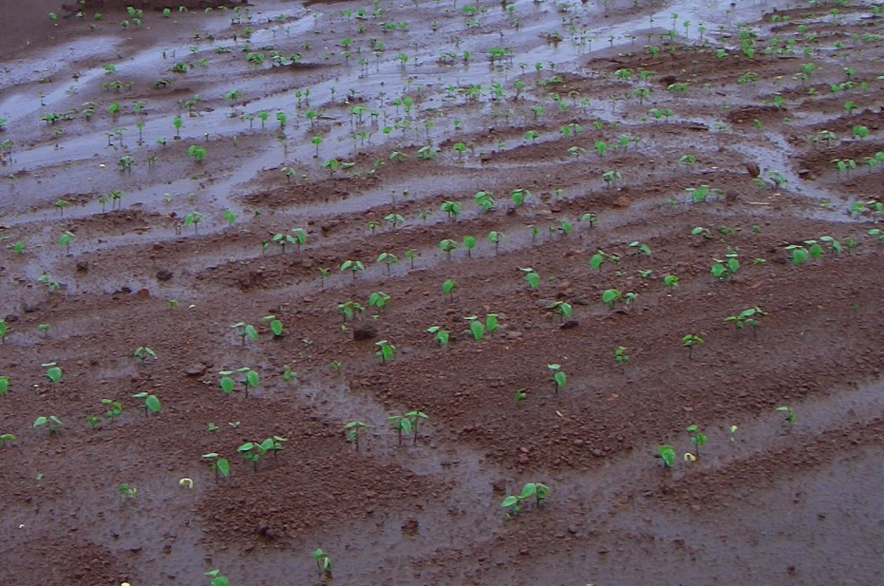
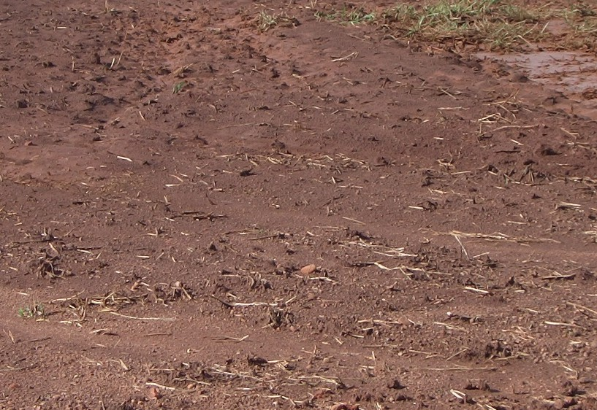

Slide 4
The theory: spherical drop on a rigid surface
Huang, C.; Bradford, J.M.; Cushman, J.H. (1982) A numerical study of raindrop impact phenomena: the rigid case. Soil Science Society of America Journal 46: 14-19.
Use techniques of material engineering that study high speed liquid‑solid impact phenomena (turbine blades, airplane wings, and windows).
Mechanistic approach rather than ‘black box’ as usual in agriculture.
Calculated the compressive stress from the impact and the shearing stress from the lateral jetting.

Slide 5
The time history of velocity:
Raindrop of 4 mm traveling at 10 m s⁻¹
(fall velocity normalized to 1)
High speed lateral jet stream:
large shearing stress at the surface
tensile failure on surface irregularities

Slide 6
The time history of pressure:
Raindrop of 4 mm traveling at 10 m s⁻¹
(reference pressure = 50 kPa, normalized to 1)
High initial pressure:
extremely high (1,200 kPa) pressure at the very instant of impact
high capacity to deform plastic surfaces
Soil shear stress: 2 to 20 kPa

Slide 7
The practice: high speed photography of drops impacting soil
Al‑Durrah, M.M.; Bradford, J.M. (1982) The mechanism of raindrop splash on soil surfaces. Soil Science Society of America Journal 46: 1086-1090.
High speed photography (2,000 frames s⁻¹) in laboratory study (rain tower with drops of 4.6 mm falling from 890 cm)
Different soils varying shear strength by changing bulk density and matric potential in the range of ~ 1 to ~20 kPa
Splash angle and relative velocity

Slide 8
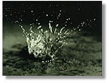

Slide 9
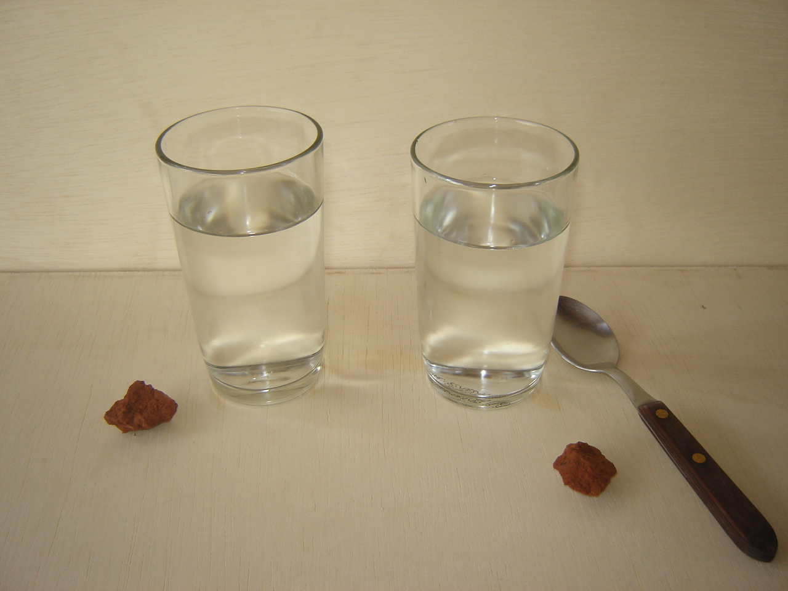

Slide 10
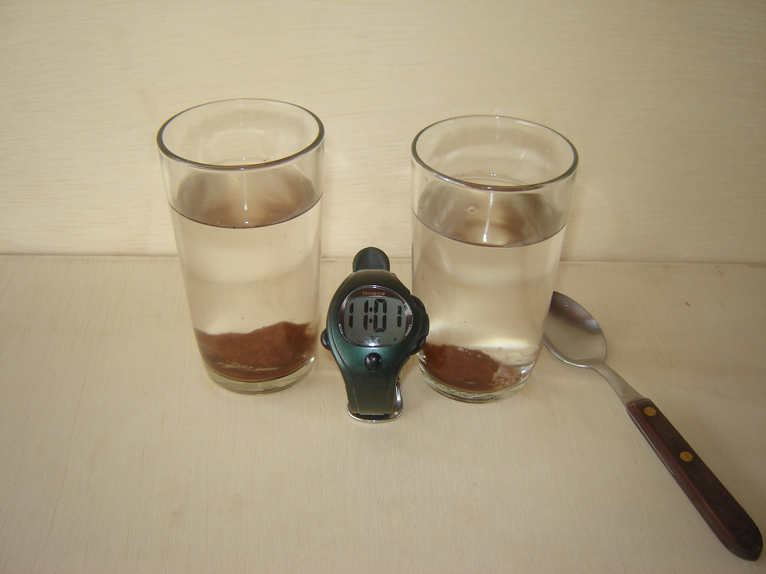

Slide 11
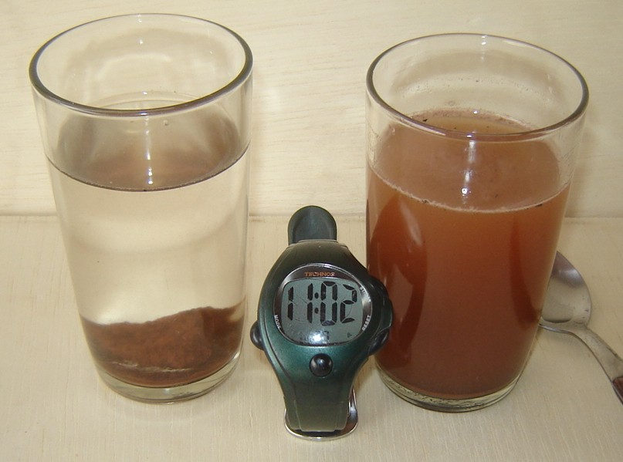

Slide 12
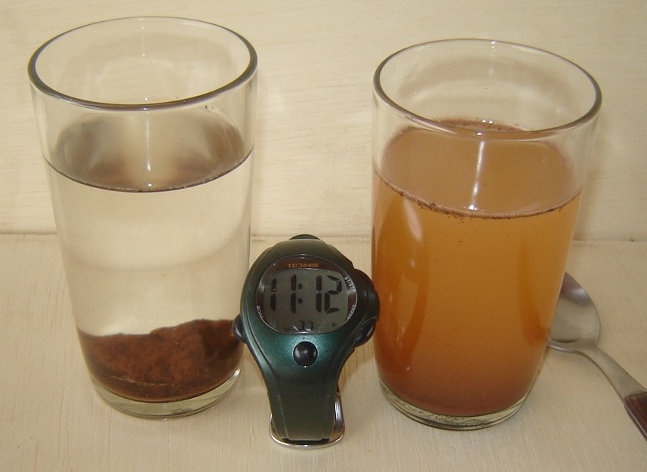

Slide 13
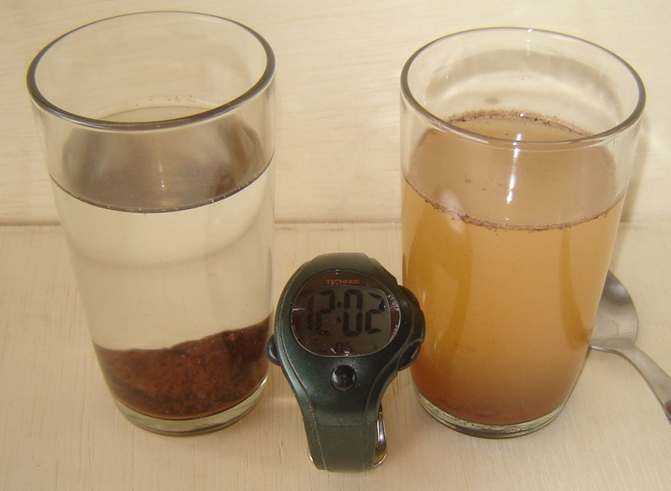

Slide 14
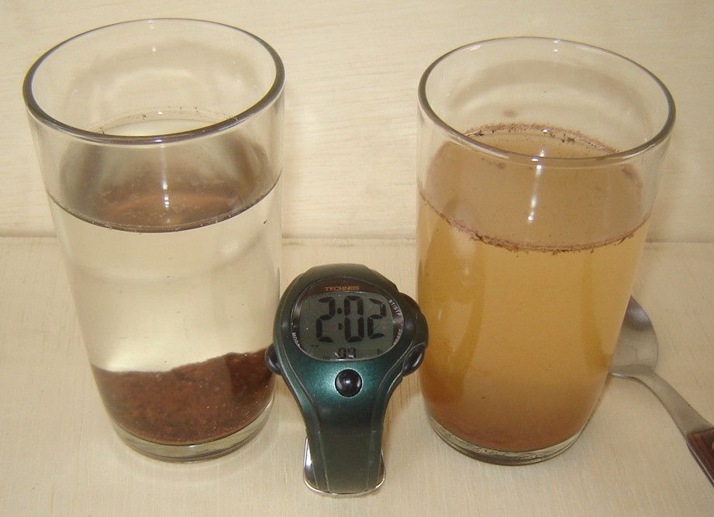

Slide 15
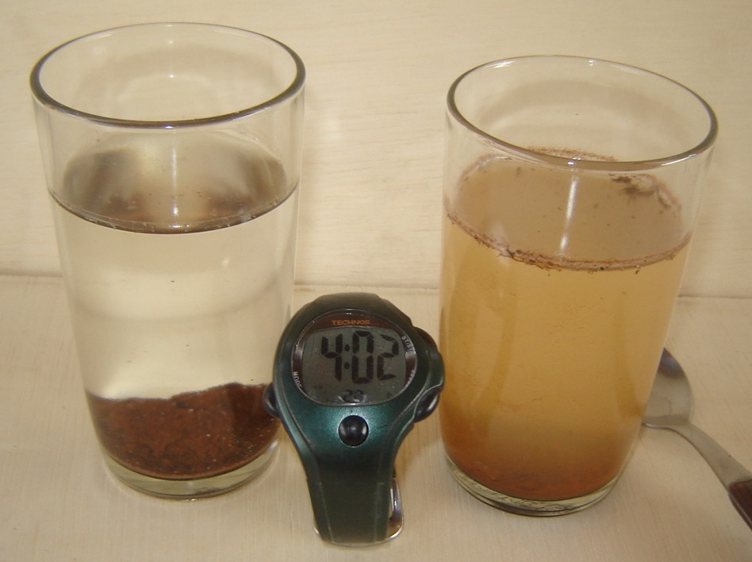

Slide 17
Roughness, runoff and soil loss
Helming, K., Römkens, M.J.M., Prasad, S.N. (1998) Surface roughness related processes of runoff and soil loss: a flume study. Soil Science Society of America Journal 62: 243-250.
Effect of roughness on spatial distribution of runoff and flow concentrations affecting the amount of soil loss.
Rain simulation, 2.8 m flume, three roughness conditions (rough, medium and smooth) two slopes (2, 8 and 17 %).
Roughness was calculated from DEM obtained from laser microrelief measurements.

Slide 20
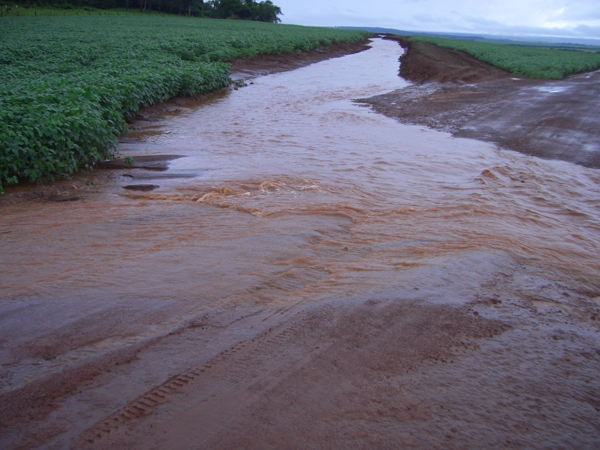
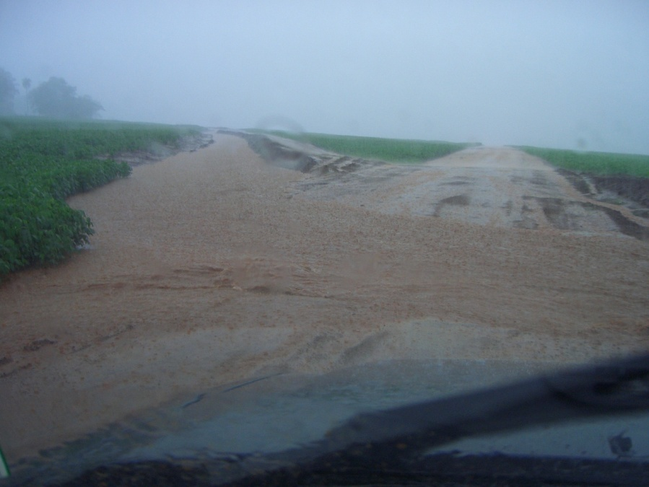
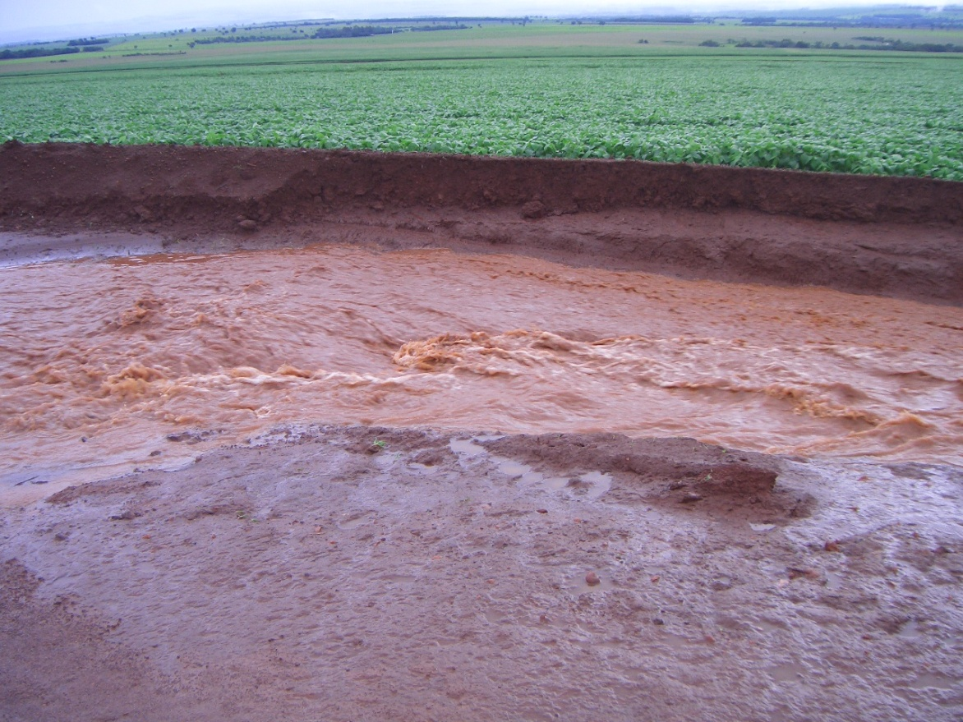
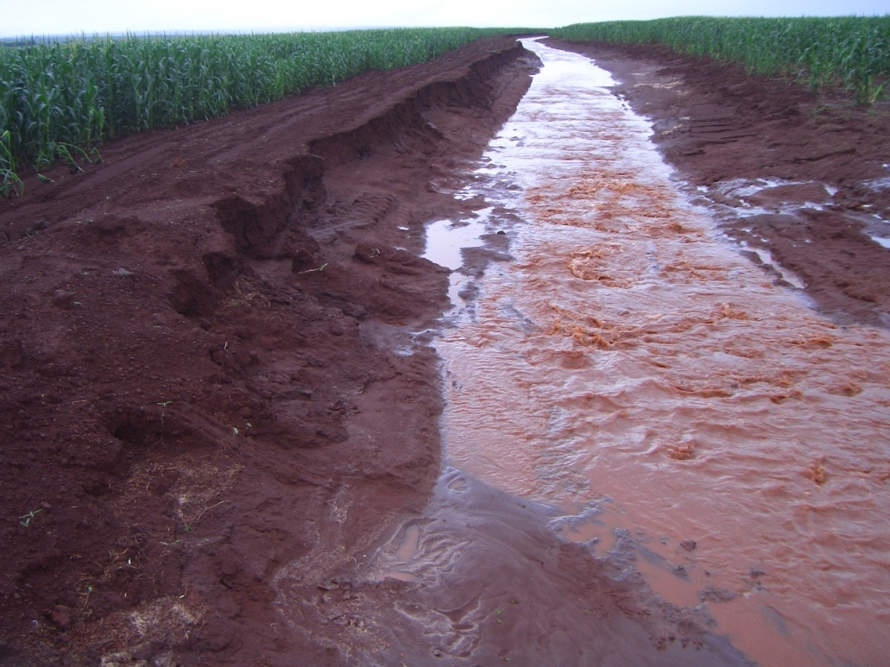

Slide 21
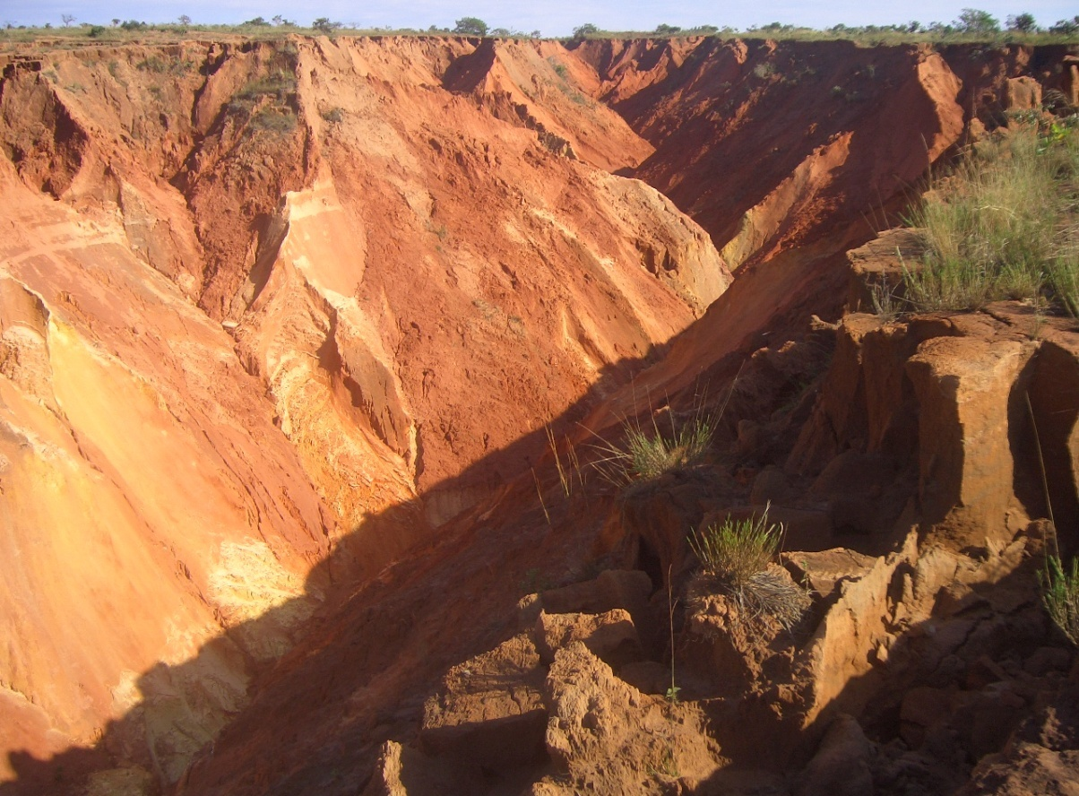
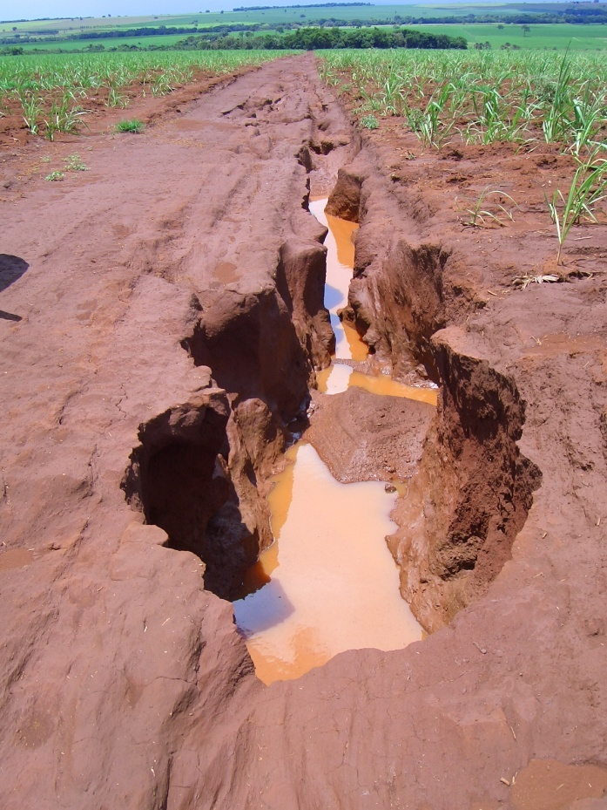
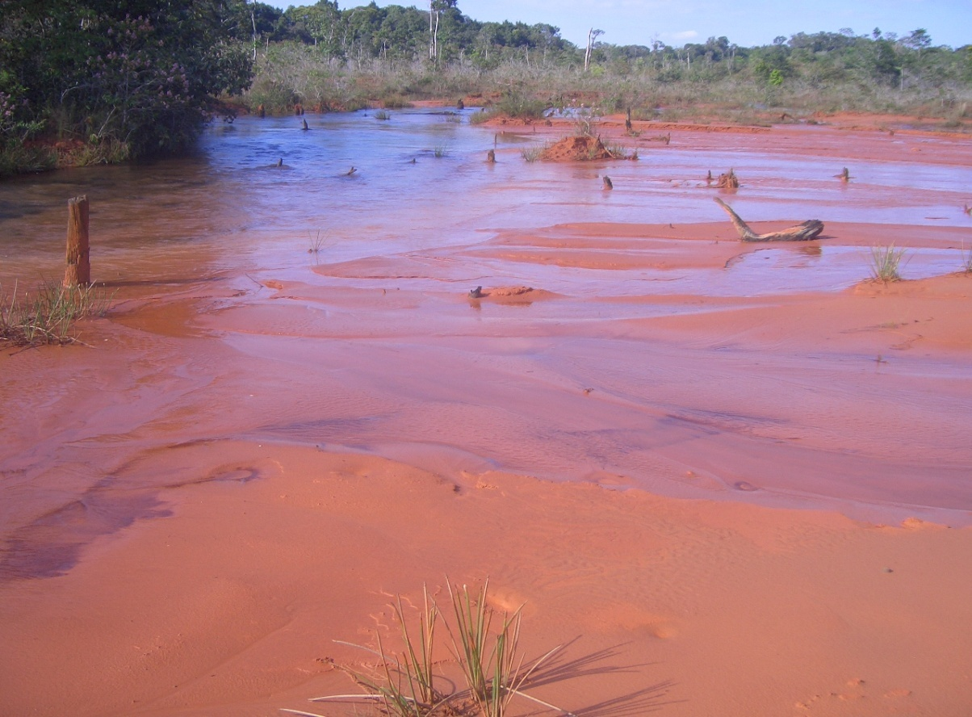

Slide 22
A erosão do solo: Processo
Desprendimento -> Transporte -> Deposição
Desagregação:
Forças de adesão e coesão em função da agregação do solo
Quantidade de energia disponível
Diminuição da quantidade de energia
Impacto da gota de chuva
Enxurrada
Enxurrada

Slide 23
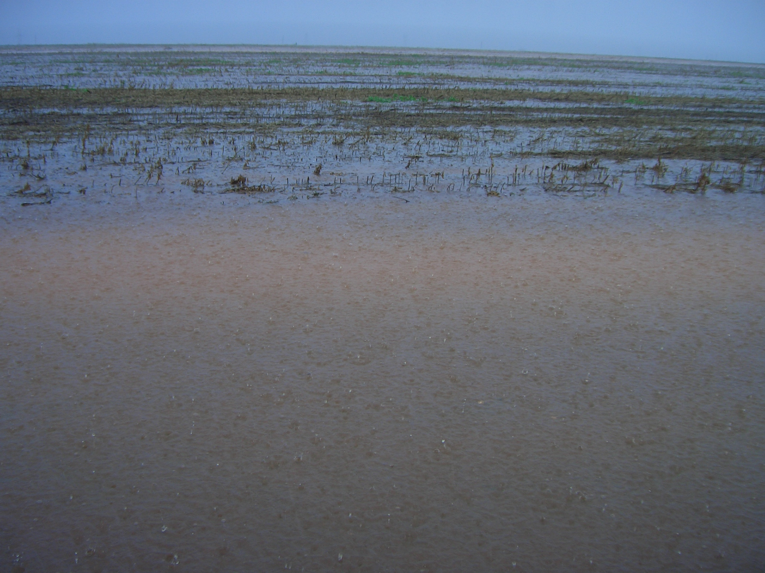

Slide 24
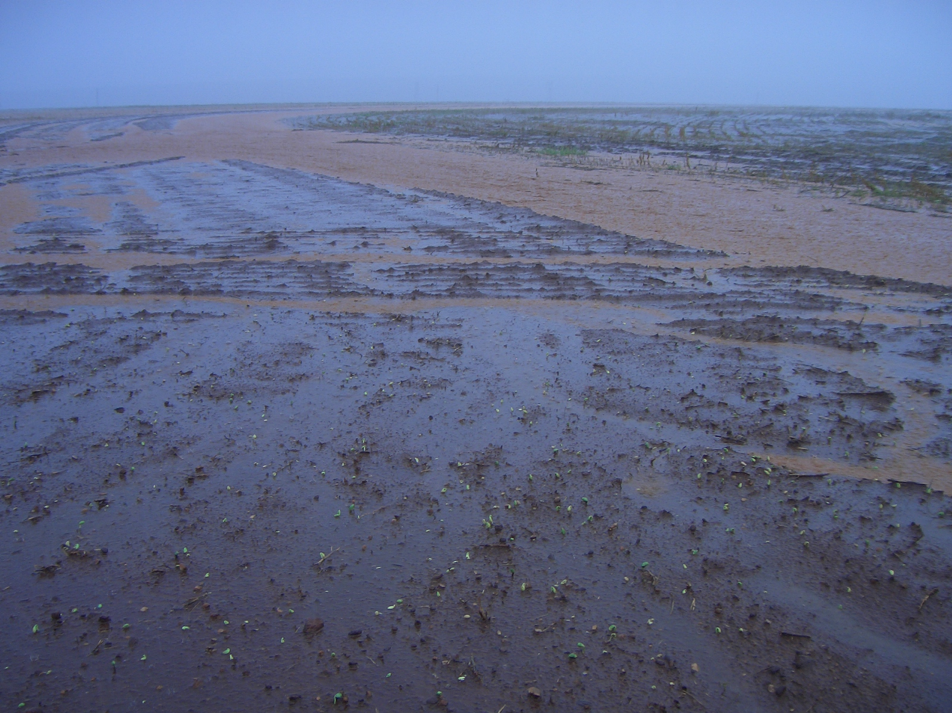

Slide 25
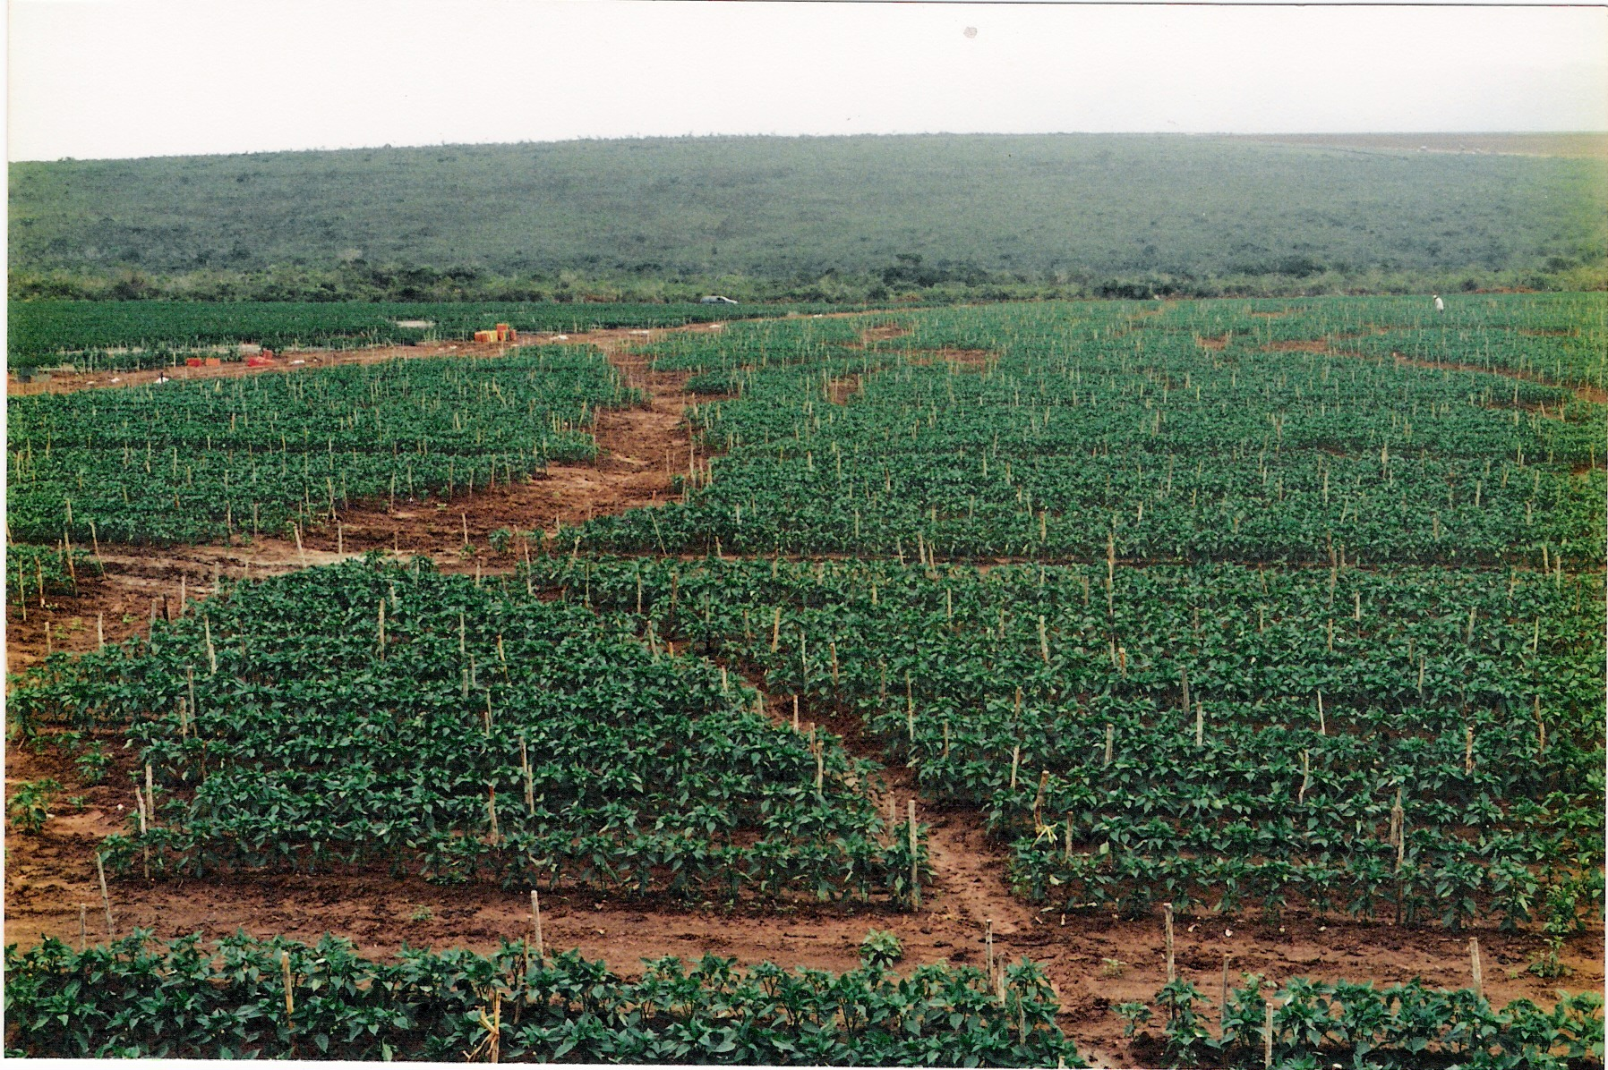

Slide 26
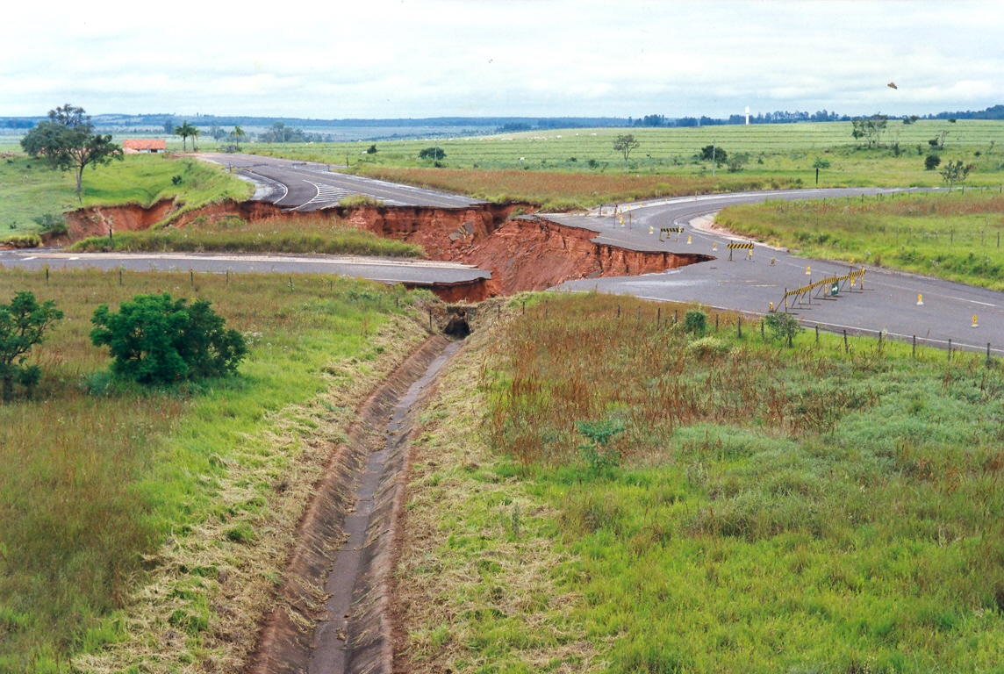

Slide 27
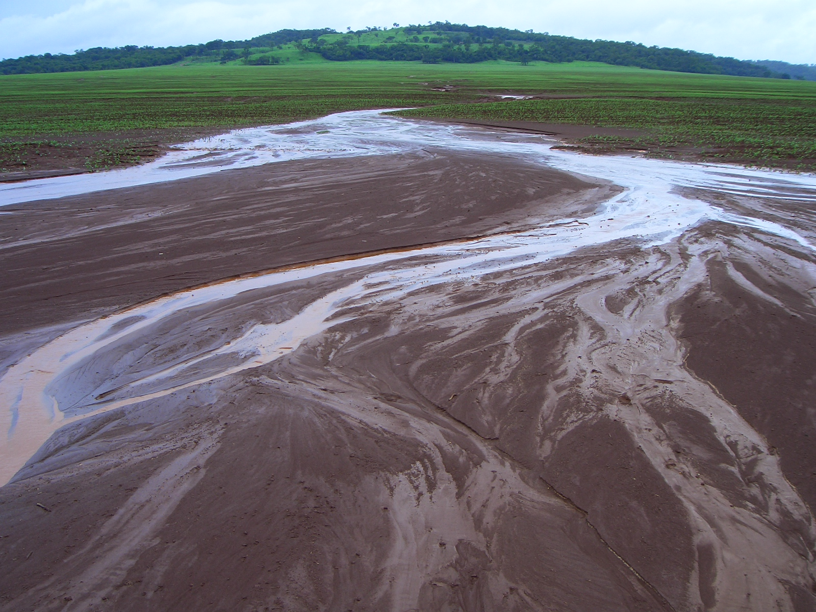

Slide 28
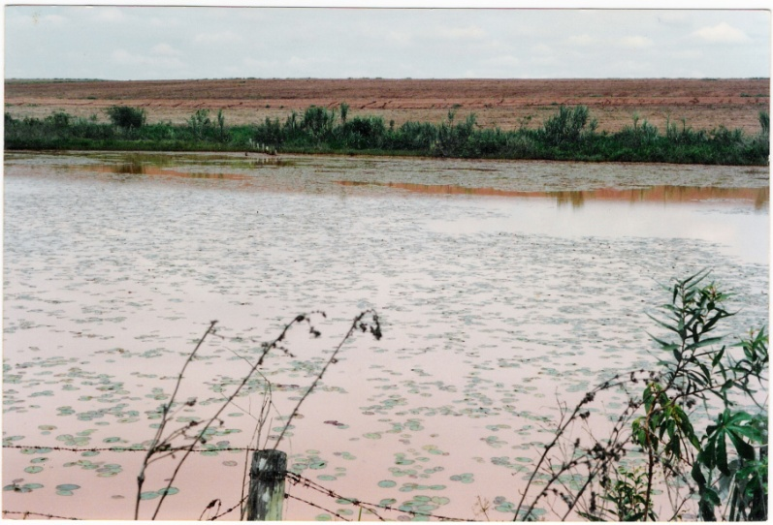
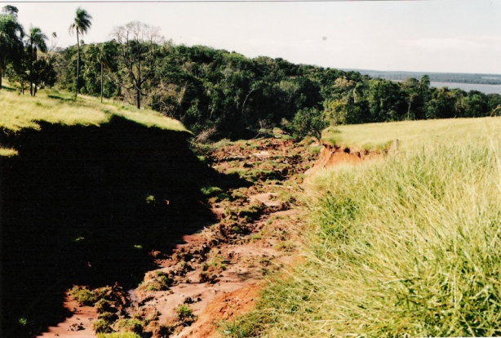
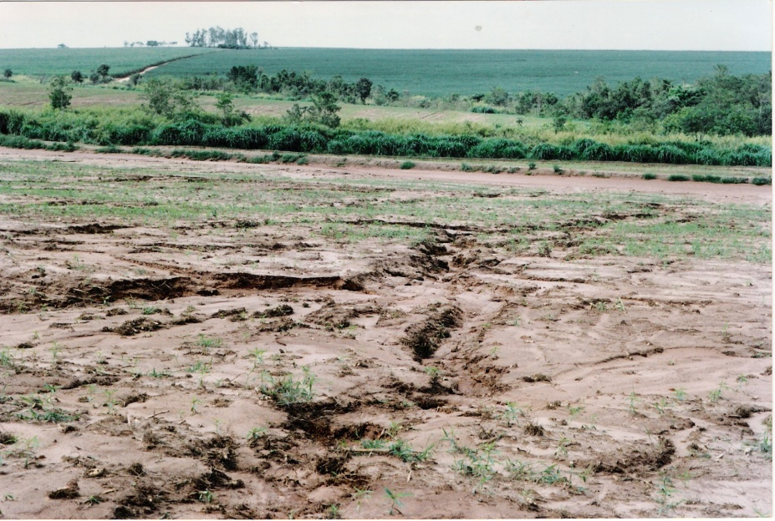
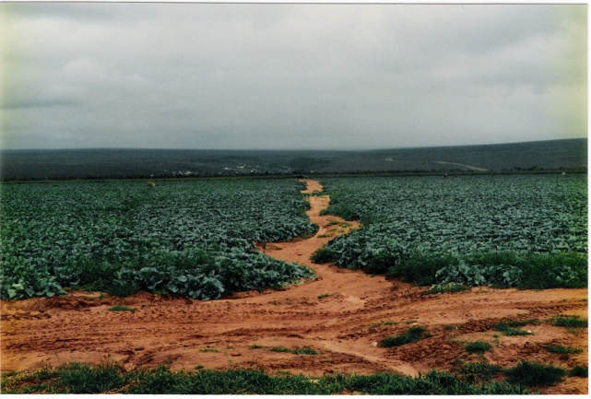
A erosão do solo: Formas
Desprendimento
seletivo
Deposição a longa distância
Impacto da gota
Laminar
Enxurrada
Dispersa
Sulcos
Desprendimento
Deposição ao longo da vertente
Concentrada
Voçorocas efêmeras
Desprendimento
e deposição próximos
Voçorocas permanentes

Slide 29
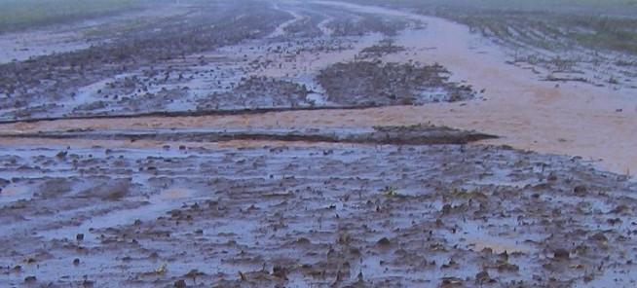
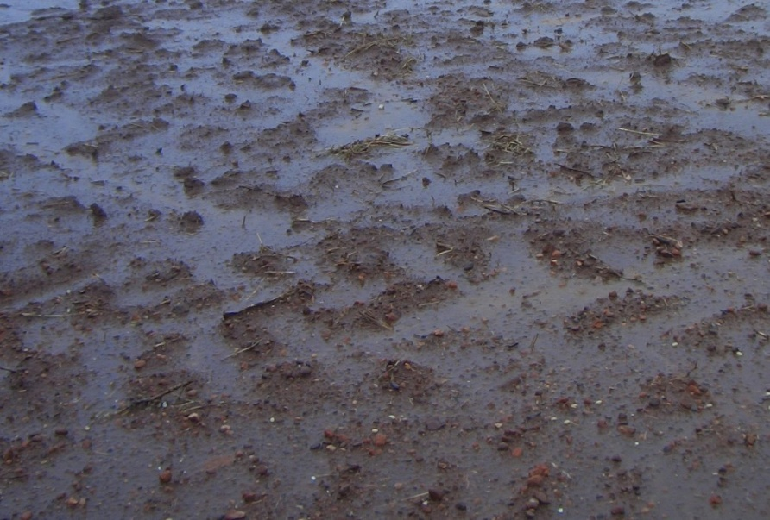
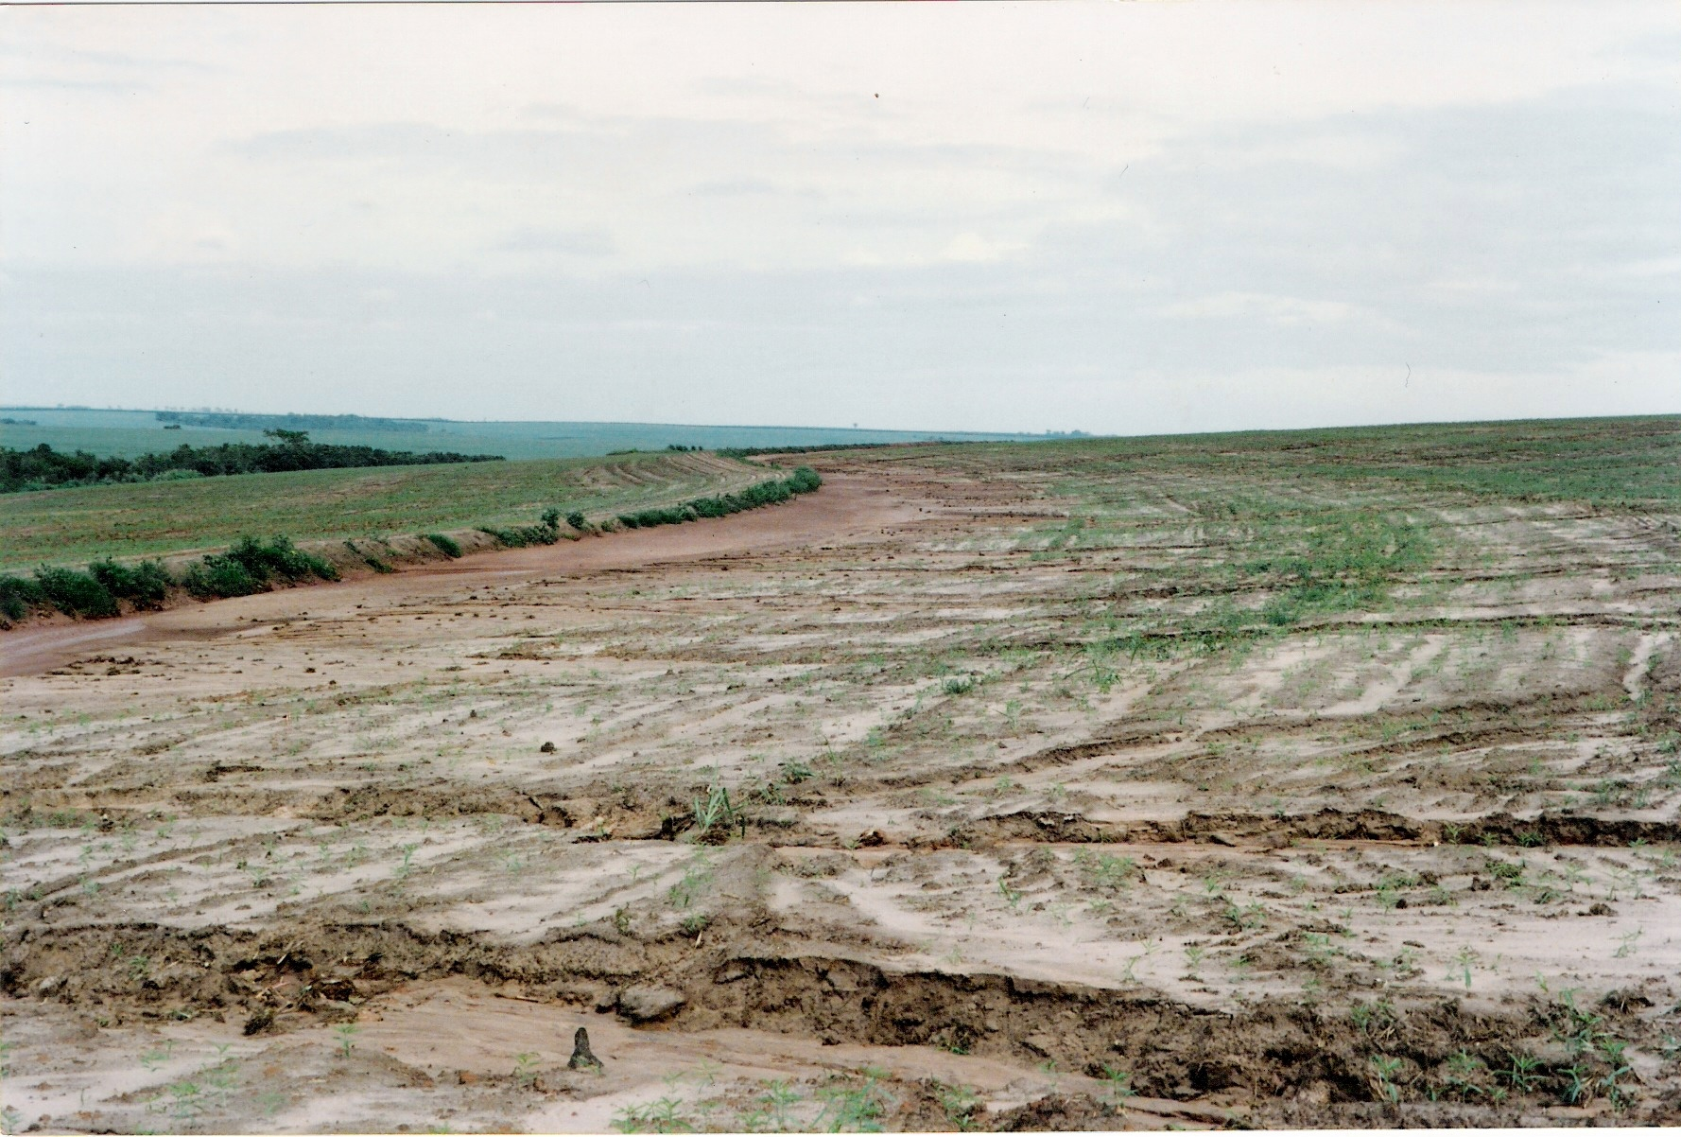

Slide 30
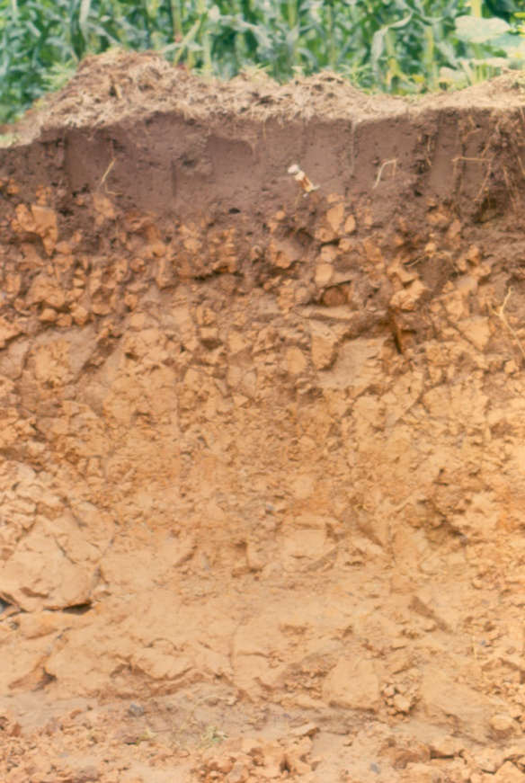
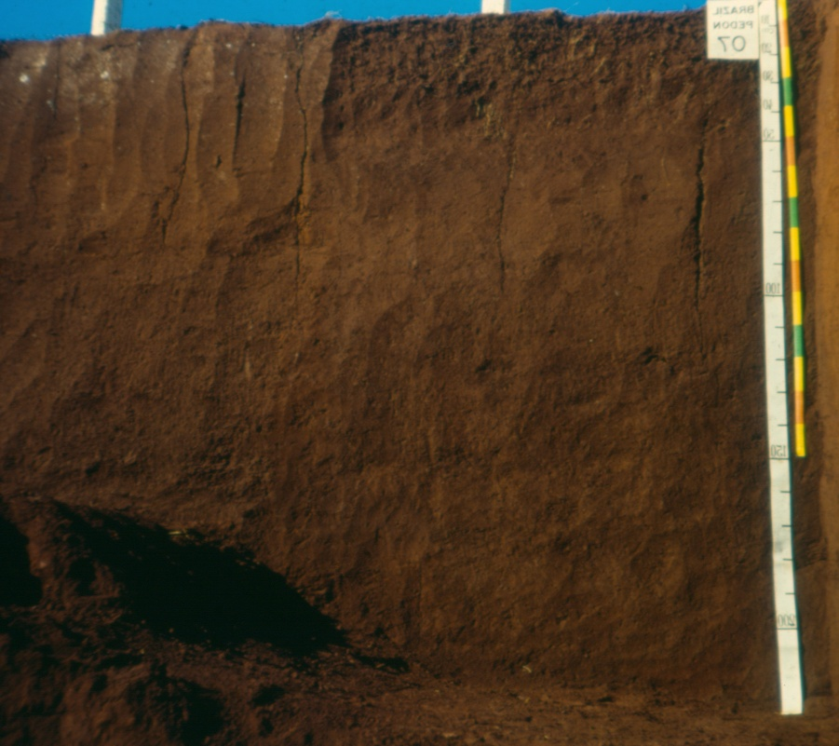
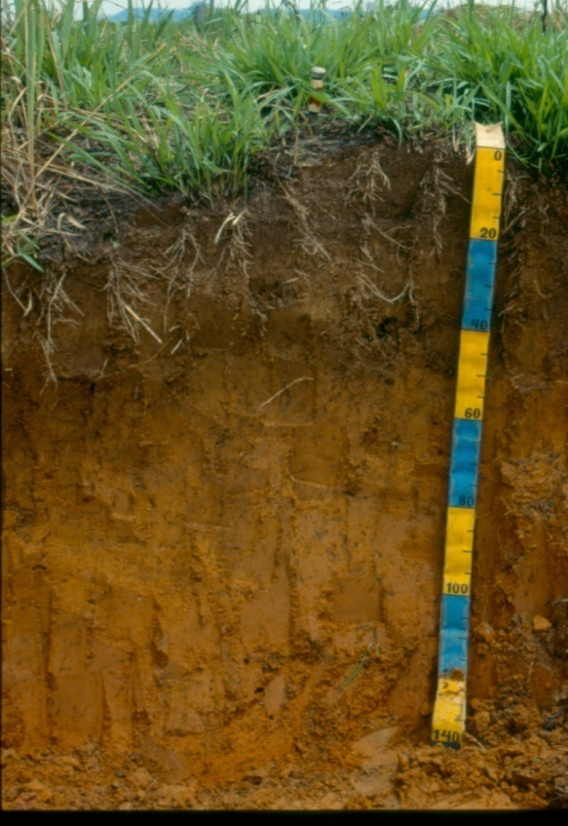
A
Rocha (siltito)
Latossolo
A
Horizonte E arenosos
Bt

Slide 31
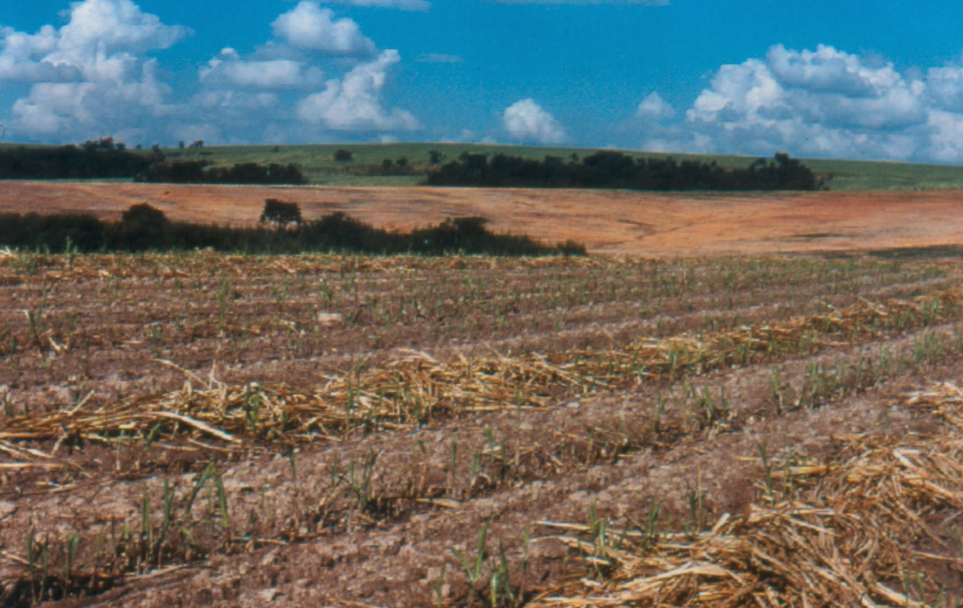
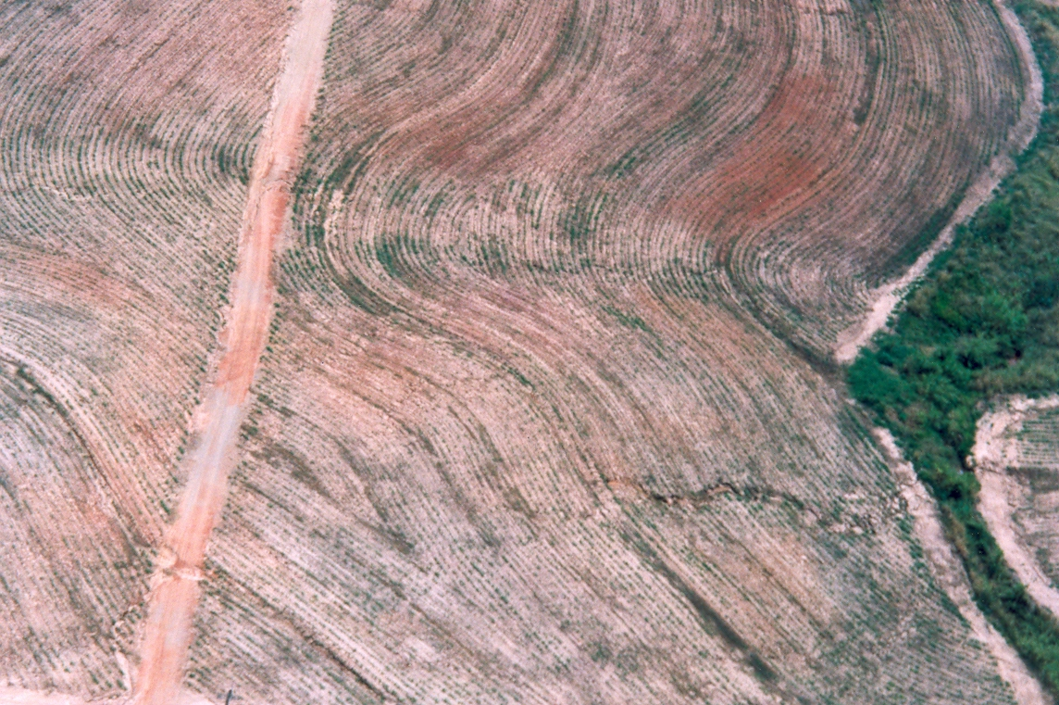

Slide 32
